Slide 1

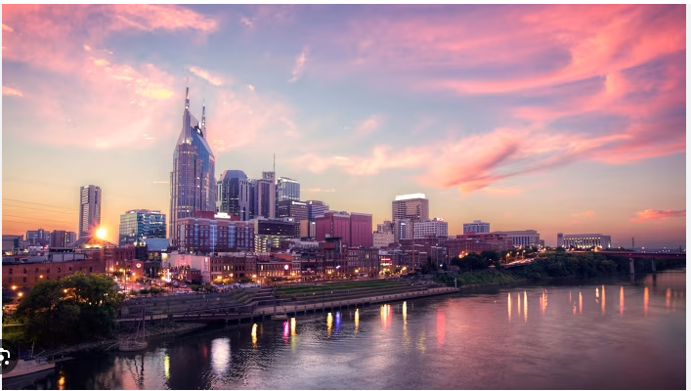
Music City Analysis by Building Permits
Tiffany Conway DA12 Capstone

Slide 2
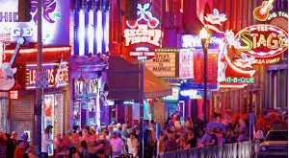


Project Overview
Motivations
Construction Cost
Location of permits
Why are people moving to Nashville
Is growth going to continue
Commercial and by each permit type
Residential and by each permit type
Commercial Building locations
Residential building locations

Slide 3
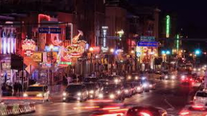
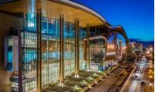

Motivations
Growth
Why
Sports
86 people daily average moving here
Nashville Projected to grow by 97.4% from 2022 to 2060
Diverse international cultures
Music, night life, Country music hall fame, Music City Center, African American Museum
Predators
Titans
Soccer
Sounds
Woman's Basketball coming soon

Slide 4
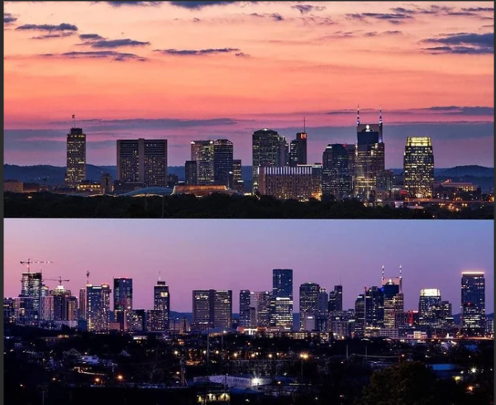
Change of Nashville
Skyline of 2015 verses skyline of 2024
Population continually increasing and with that must build homes to put the new residences
Headquarters in Nashville include Amazon, Oracle, HCA, Community Health Services, Sony, Vanderbilt, and many more

Slide 5
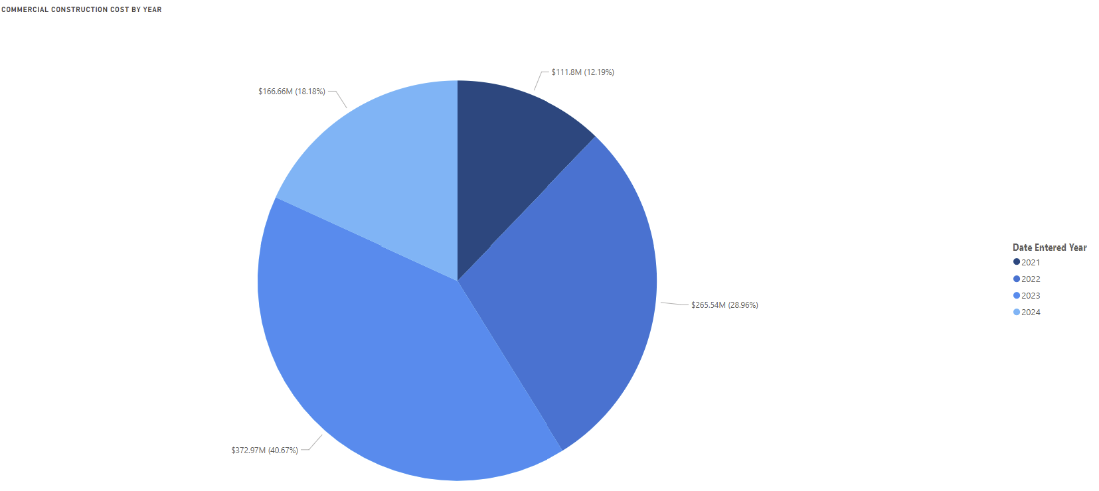
Construction costs

Slide 6
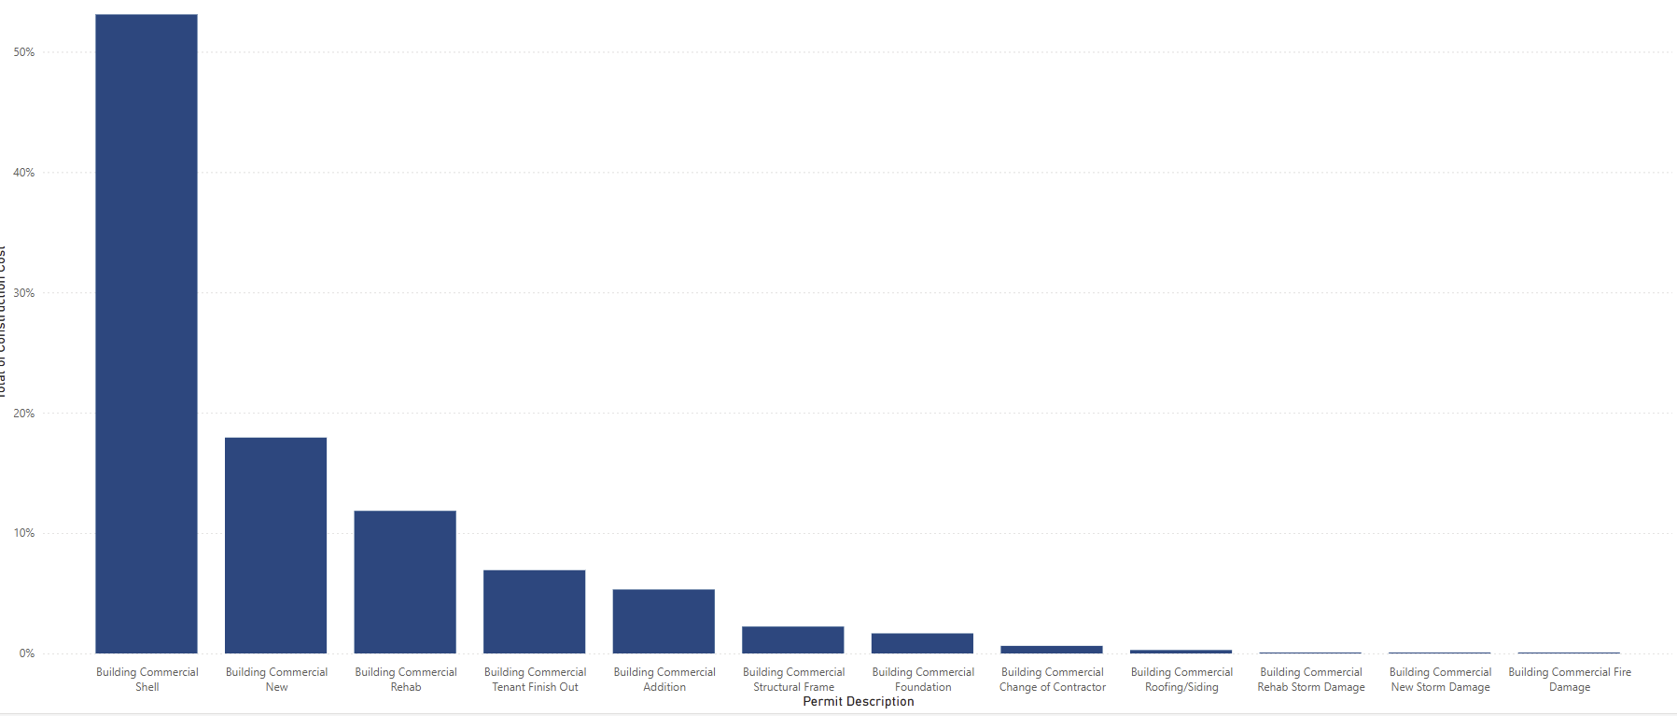
Commercial Permits

Slide 7
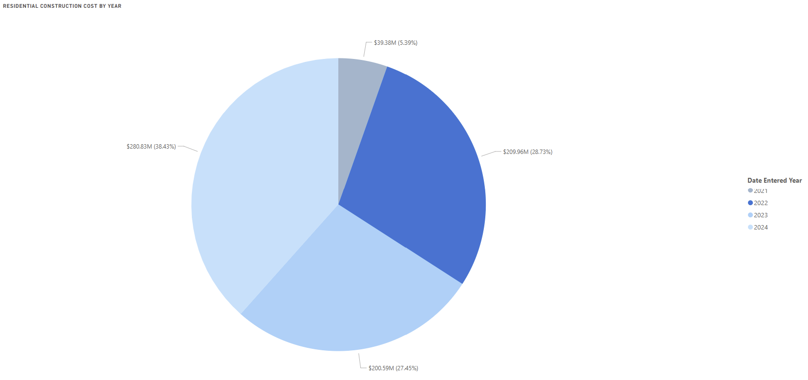
Construction costs

Slide 8
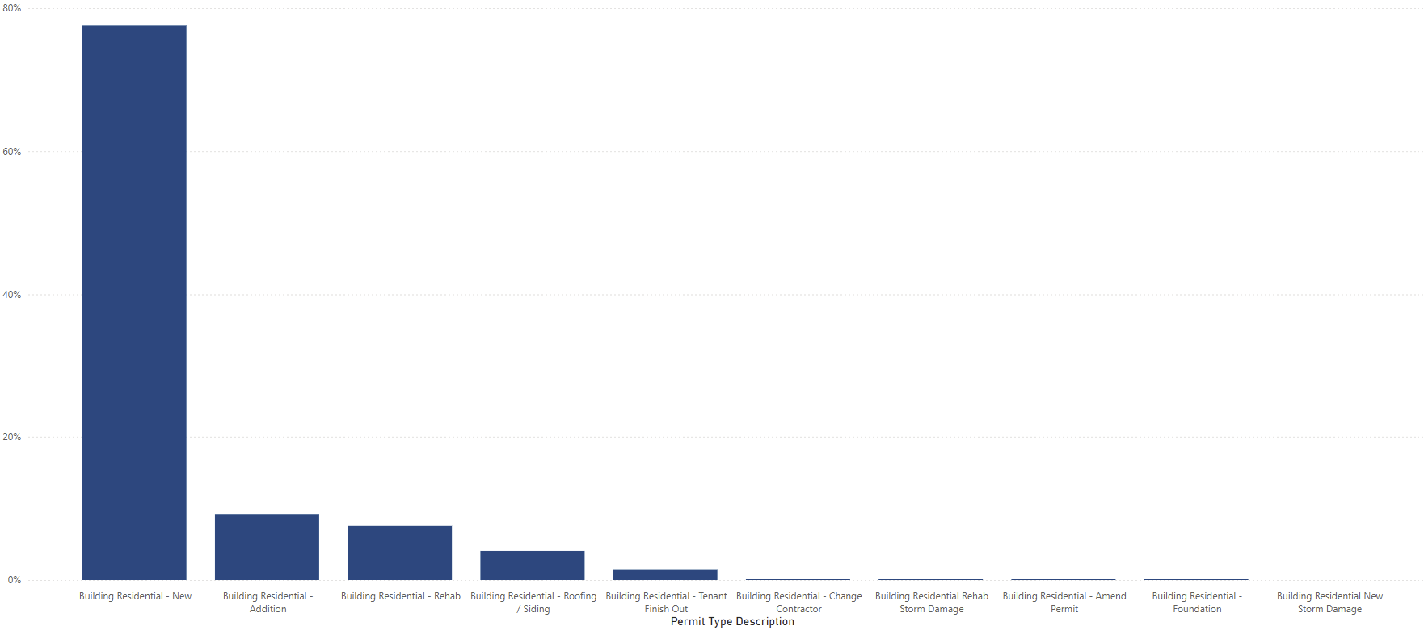
Residential Permit

Slide 9
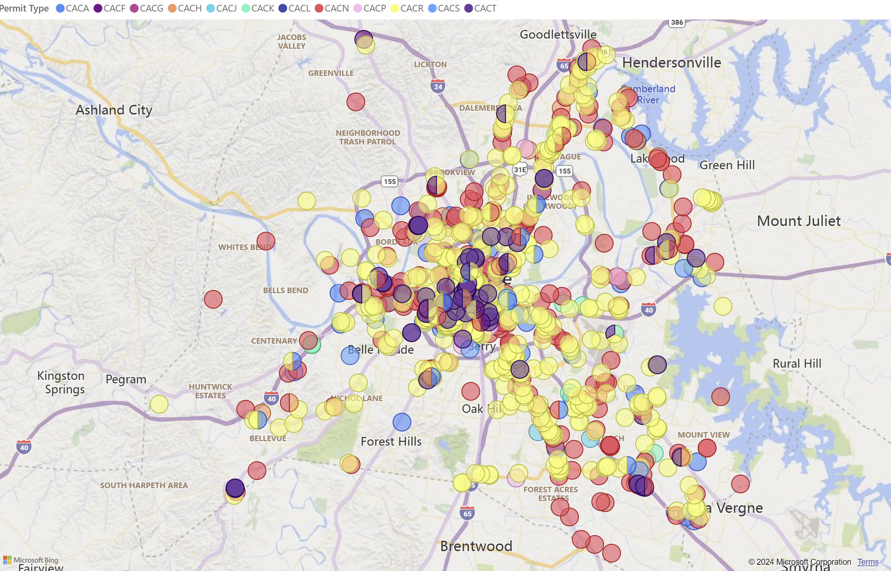
Commercial Permits pulled from 8/21 to 8/24 Permits Power BI - Power BI

Slide 10
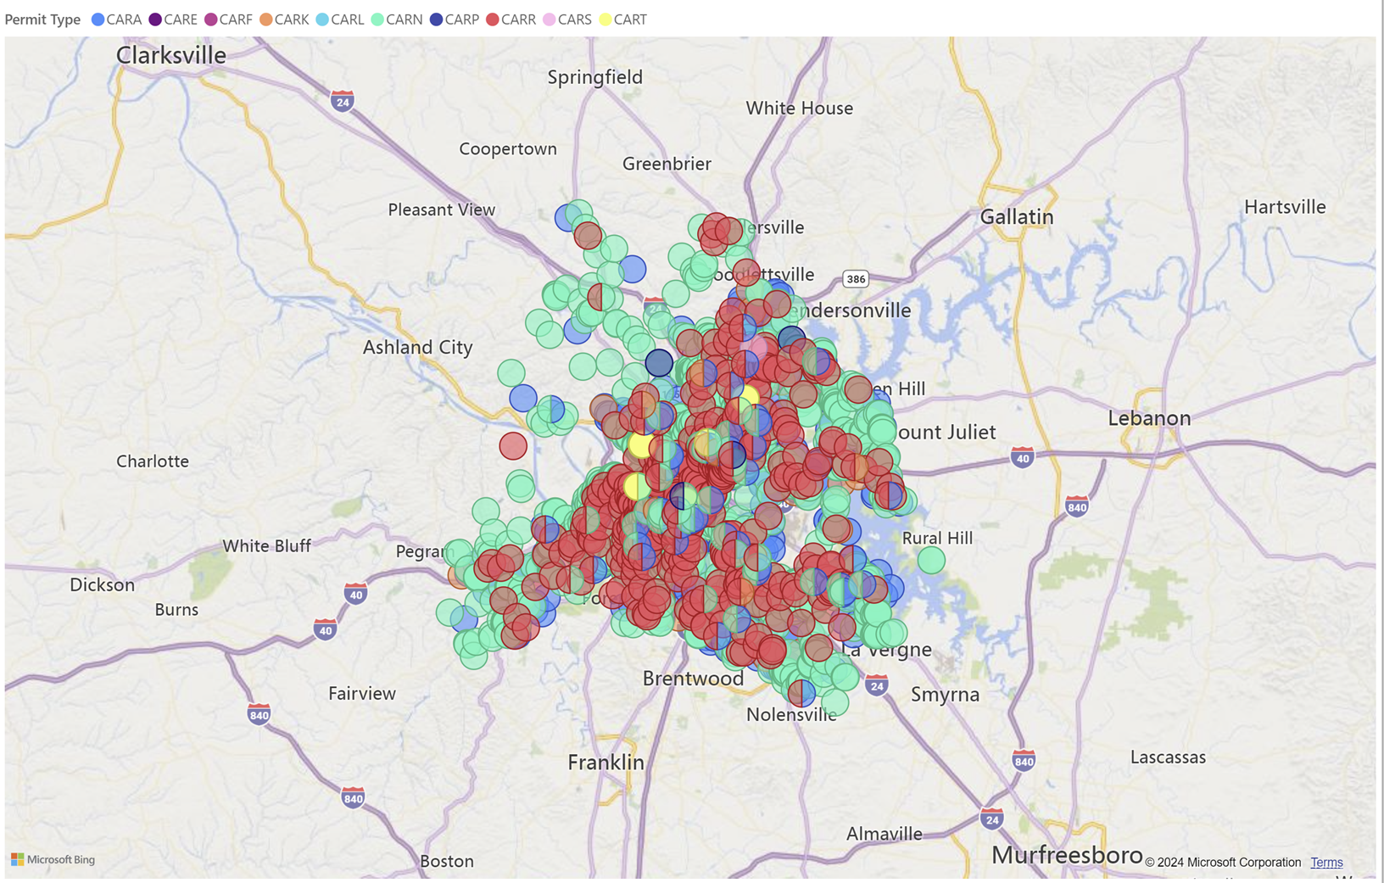
Residential Permits pulled 8/21 to 8/24 Permits Power BI - Power BI

Slide 11
Permit Types
Commercial
Residential
CACA = Building Commercial Addition
CACF = Building Commercial Foundation
CACG =Building Commercial Structural Frame,
CACH= Building Commercial Shell
CACJ = Building Commercial Fire Damage
CACK =Building Commercial Roofing/Siding
CACL= Building Commercial Rehab Storm Damage
CACN=Building Commercial New
CACR=Building Commercial Rehab
CACS=Building Commercial New Storm Damage
CACT=Building Commercial Tenant Finish Out
CACP=Building Commercial Change of Contractor
CARA= Building Residential Addition
CARE= Building Residential Amend Permit
CARF=Building Residential Foundation
CARK=Building Residential Roofing/Siding
CARL= Building Residential Rehab Storm Damage
CARN=Building Residential New
CARR=Building Residential Rehab
CARS=Building Residential New Storm Damage
CART=Building Residential Tenant Finish Out
CARP=Building Residential Change of Contractor

Slide 12
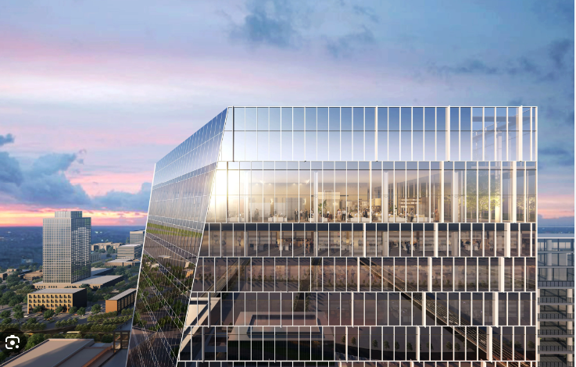
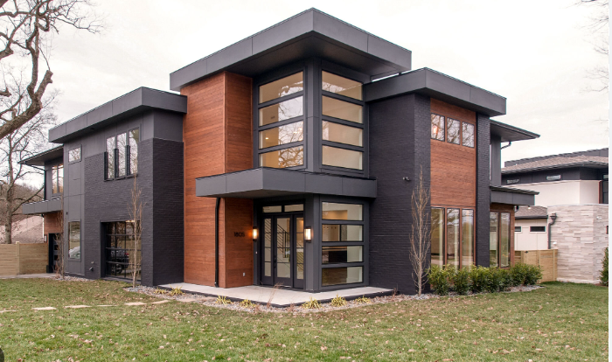

Recap
Commercial
Residential
Growth
916.97 million over 4 year span
Total Construction costs over all permits 730.75 million
Career path will stay the same as well confirmed that want to be apart of the growth in music city

